Slide 1
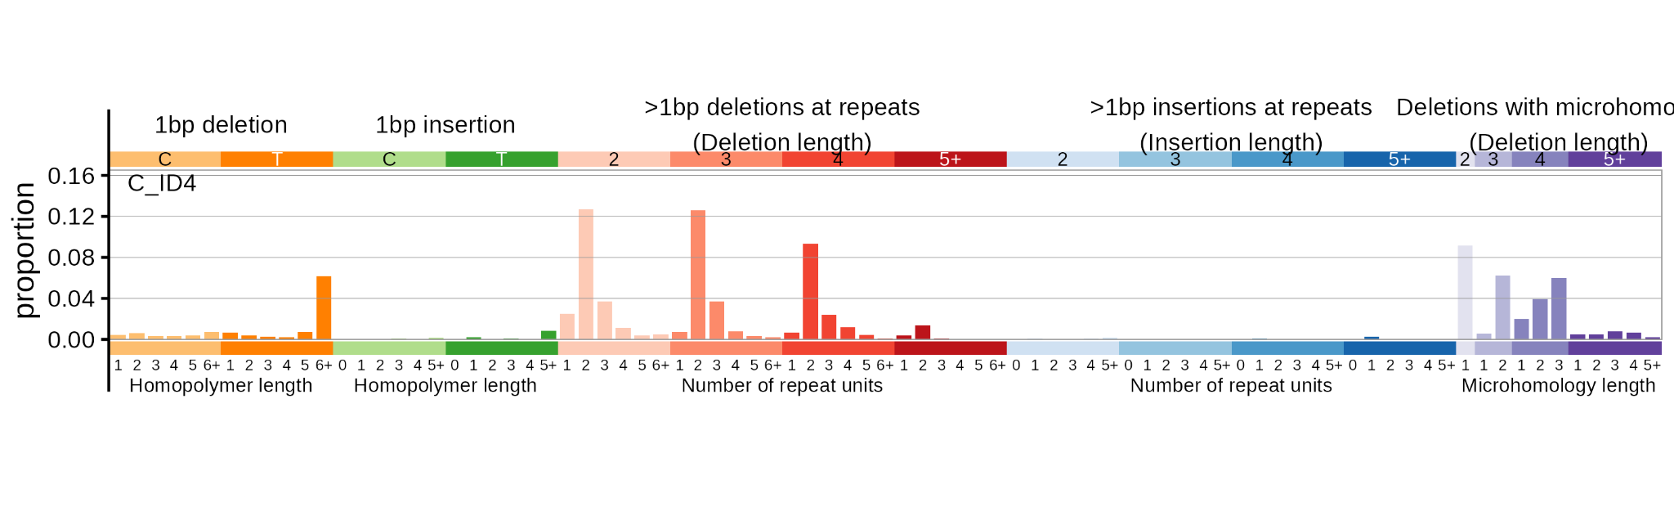
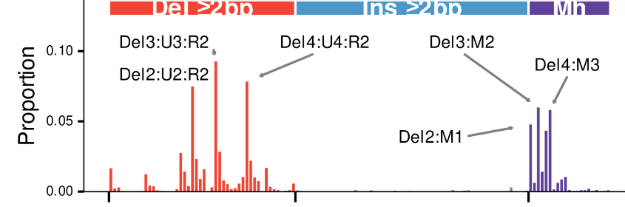
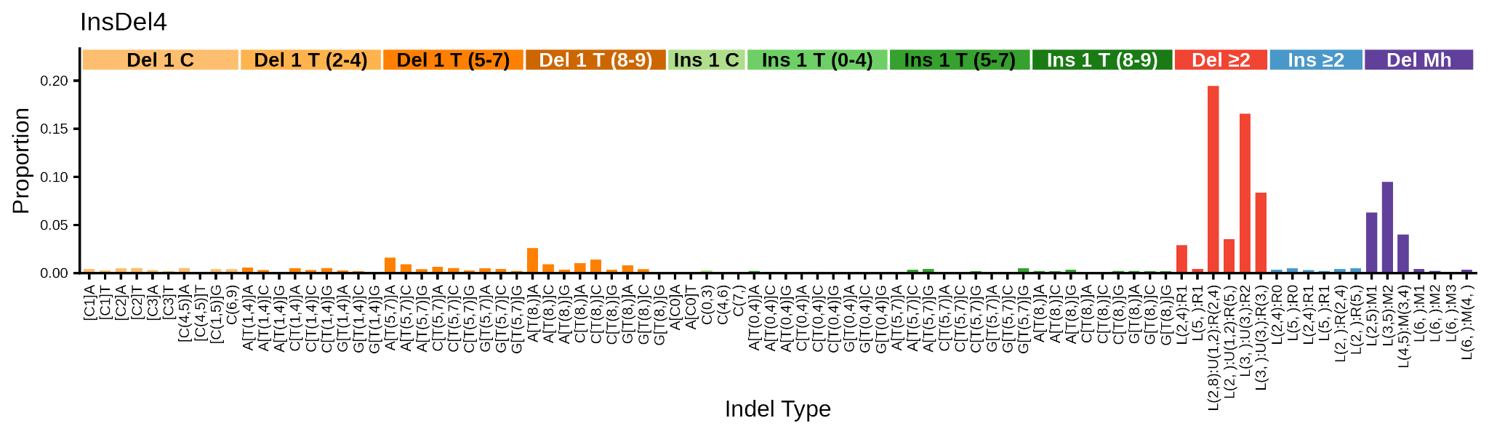
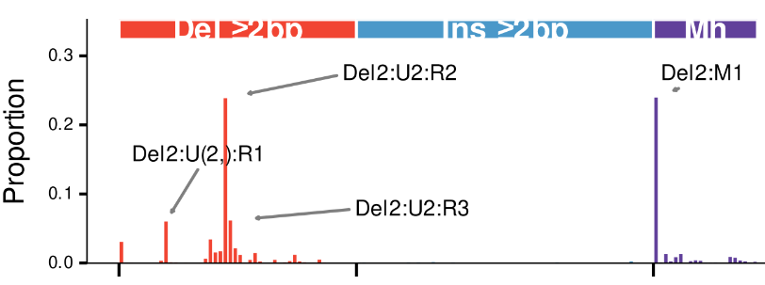
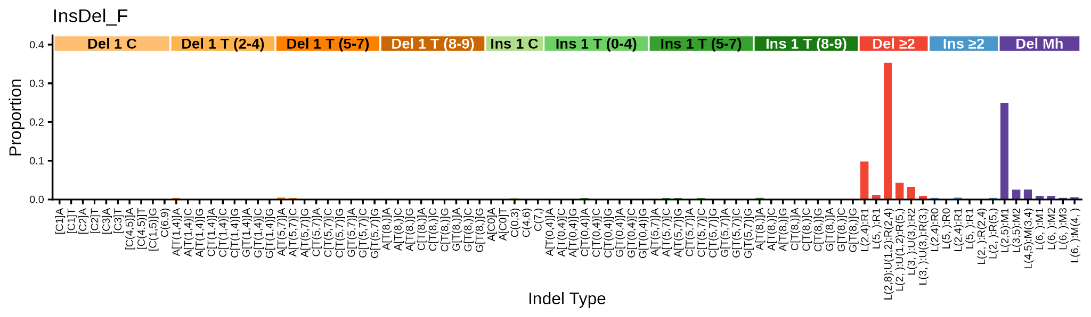
Previous hypothesis
4
Correct signature of RNase H2 deficiency
F

Slide 2
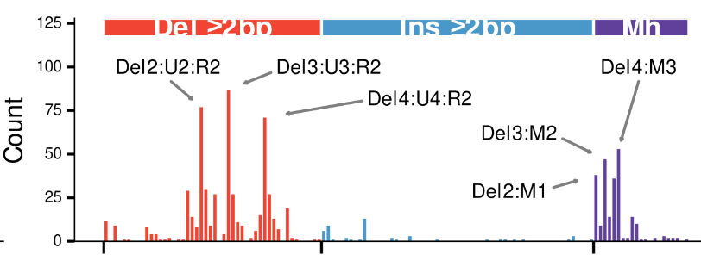
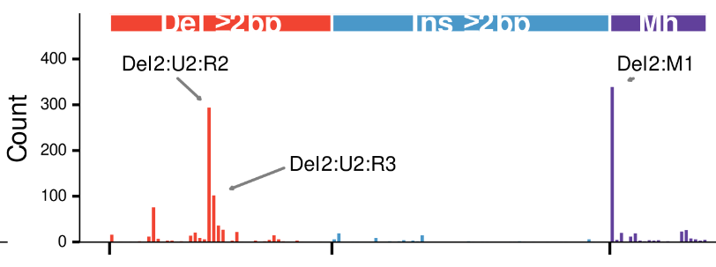
Previous hypothesis
4
Correct signature of RNase H2 deficiency
F
Human tumor dominated by signature 4
Human tumor dominated by signature F

Slide 3
Previous hypothesis
4
Correct signature of RNase H2 deficiency
F
"Del3:U3:R2"
TCTTCT→TCT
CTTCTT→CTT
AATAAT→AAT
…
(pref for
Cs and Ts)
"Del3:M2"
CTCCT -> CT
CTTCT -> CT
…
"Del4:M3"
AATTATT -> ATT
TTTCTTT -> TTT
…
"Del2:U2:R2"
mostly:
CTCT→CT
TCTC→TC
TGTG→TG
ACAC→AC
"Del2:M1"
mostly:
TCT→T
TGT→T

